Slide 1
Open slides

Slide 2
Observatory specific

Slide 3
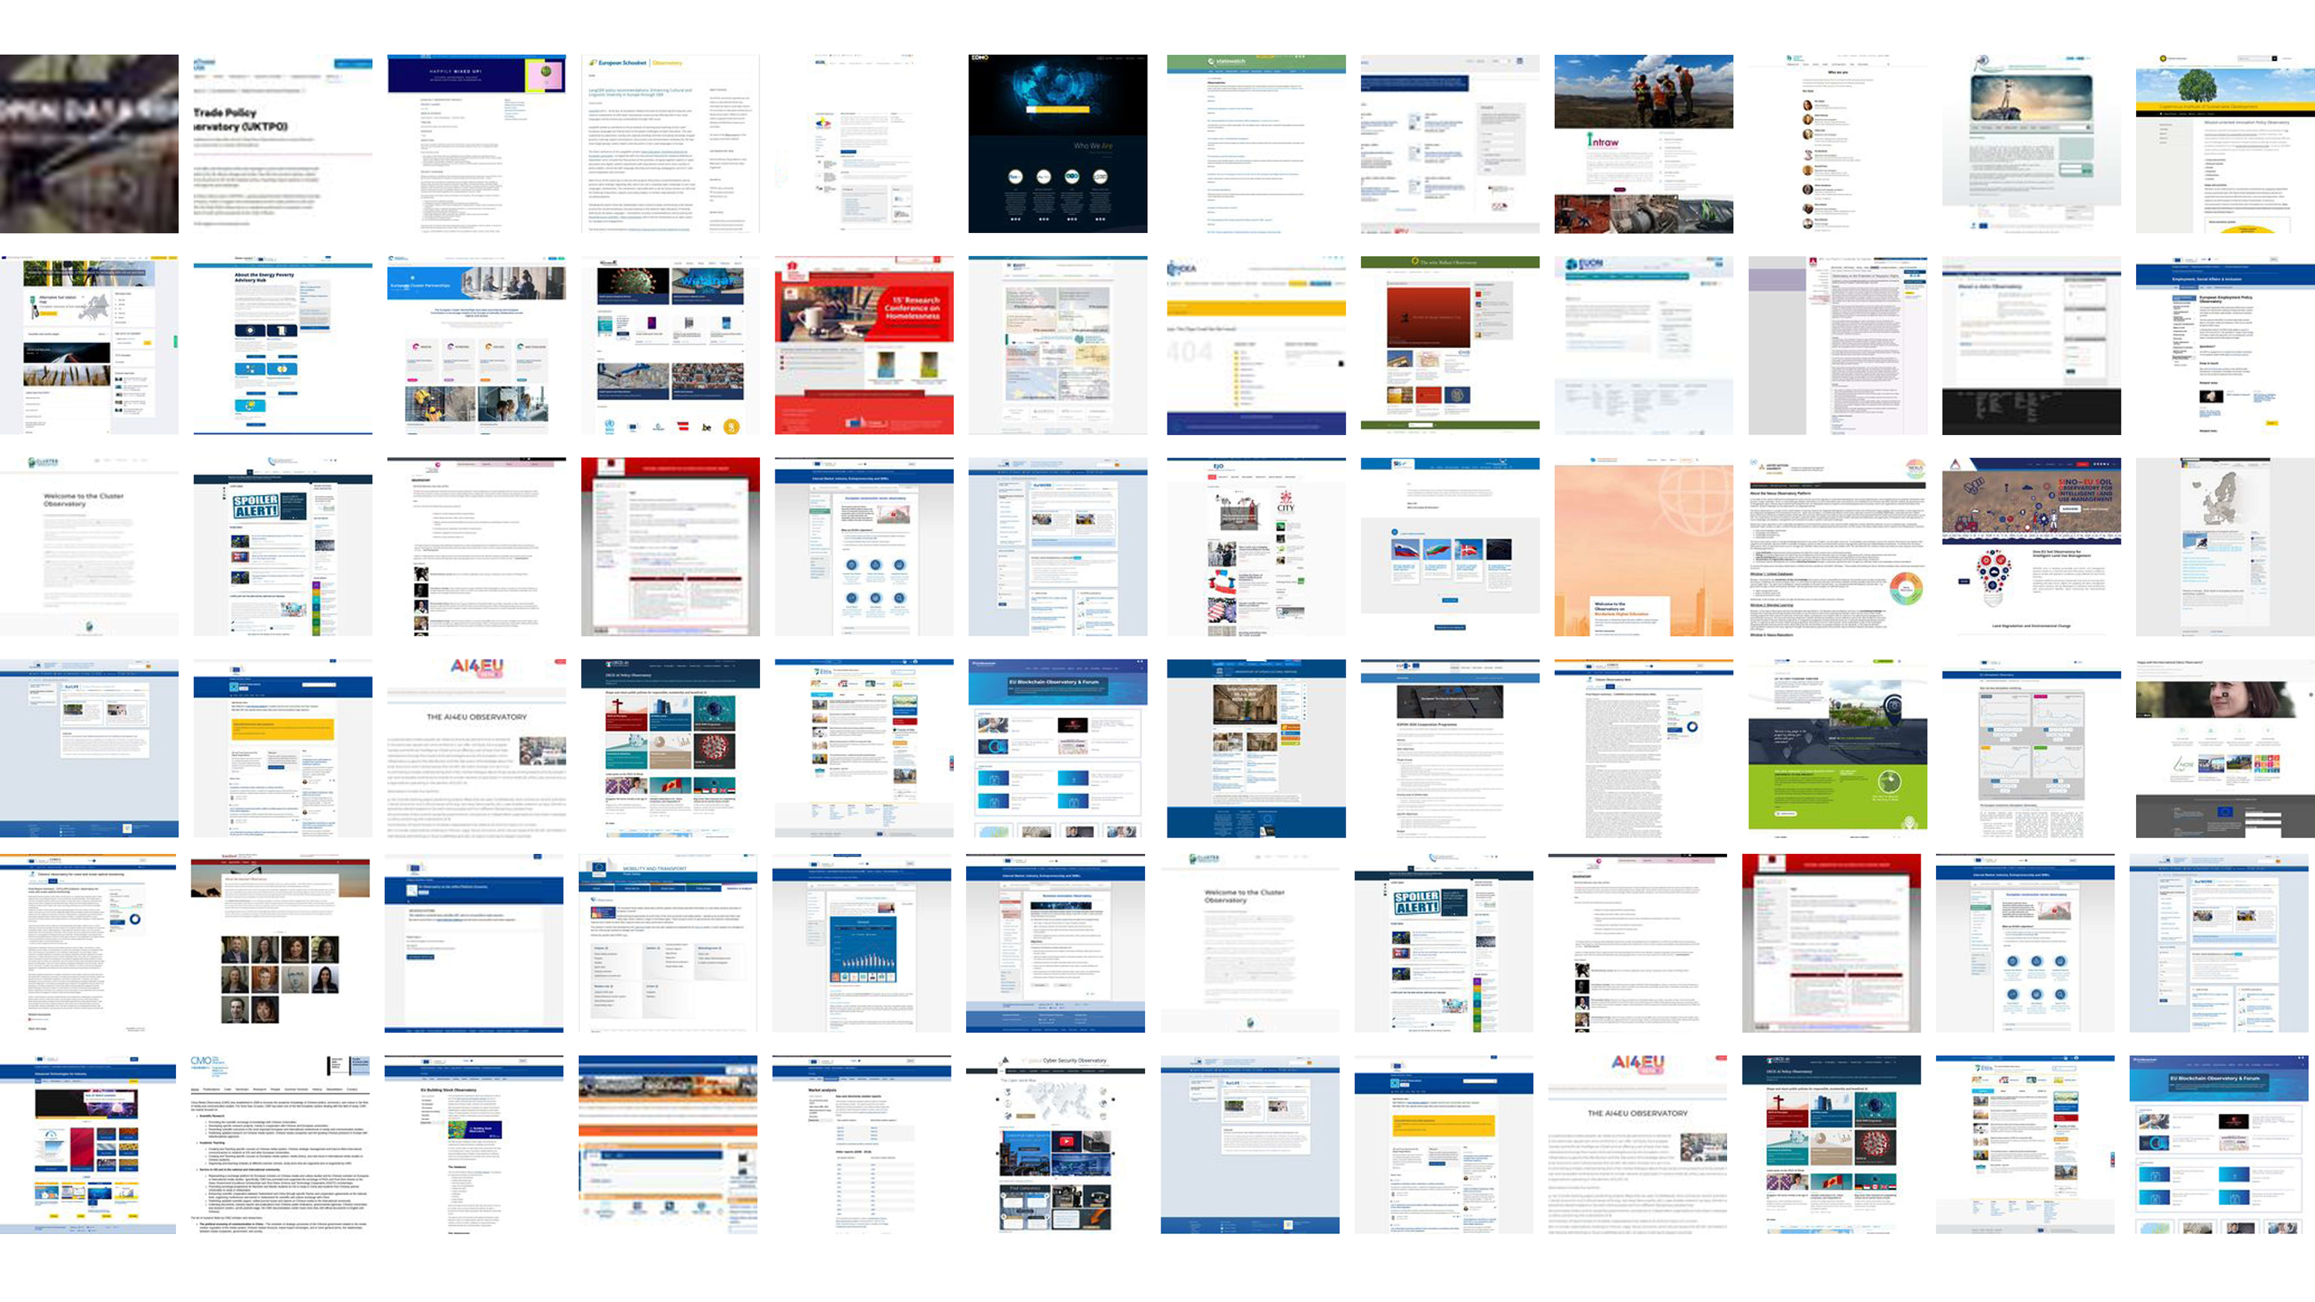
Why is Open Data Not Used?
Though data is usually valuable if it is not in isolation, open data is very difficult to join with other data. Almost never confirms the tidy data principles, which makes integration into databases or making composite indicators a very challenging data processing task.
Haphazard use of measurement units (gram vs kilogram), currencies, metadata codes (regional boundaries change several thousand times just in the EU over a few years.)
In short: open data requires investment into processing, unit testing, documentation to be usable. These are very costly operations, but we believe it can be done at scale and at a best value for money with open-source statistical code and research automation. This is what we do: create automated data observatories that reprocess, validate and automatically document open data to meet high statistical standards.

Slide 4
Observatory final opening page here

Slide 5
Why is open data not trusted?

Slide 6
Why is Open Data Not Used?
Though data is usually valuable if it is not in isolation, open data is very difficult to join with other data. Almost never confirms the tidy data principles, which makes integration into databases or making composite indicators a very challenging data processing task.
Haphazard use of measurement units (gram vs kilogram), currencies, metadata codes (regional boundaries change several thousand times just in the EU over a few years.)
In short: open data requires investment into processing, unit testing, documentation to be usable. These are very costly operations, but we believe it can be done at scale and at a best value for money with open-source statistical code and research automation. This is what we do: create automated data observatories that reprocess, validate and automatically document open data to meet high statistical standards.

Slide 7
Why is Open Data Not Used?
Open data is released after primary governmental, scientific or corporate use. It is not processed and organized to the new user’s needs.
The data is poorly documented, the primary user does not have an incentive to hire a data scientist or statistician to provide important metadata for the information: it needs to be reverse engineered to figure out important aspects of the data.
The EU, OECD, an UN bodies are (co-)financing more than 60 permanent data collection points, so called ‘observatories’ or ‘data observatories. Our market research found they almost never use any form of open data. We believe that it is a wasted opportunity to spend millions of euros on each data observatory’s collection problem when billions worth of open data (at historical cost) is not even considered in them.

Slide 8
How can we build up the missing trust?

Slide 9


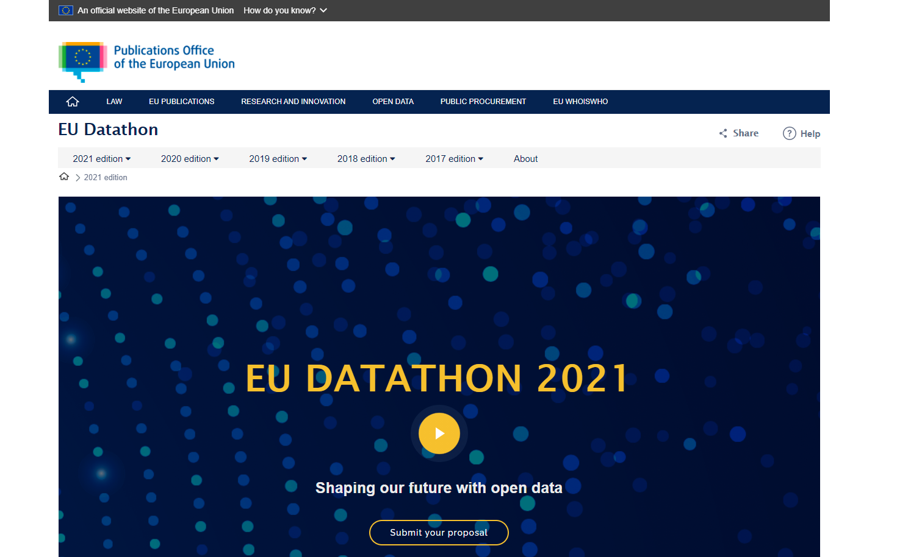
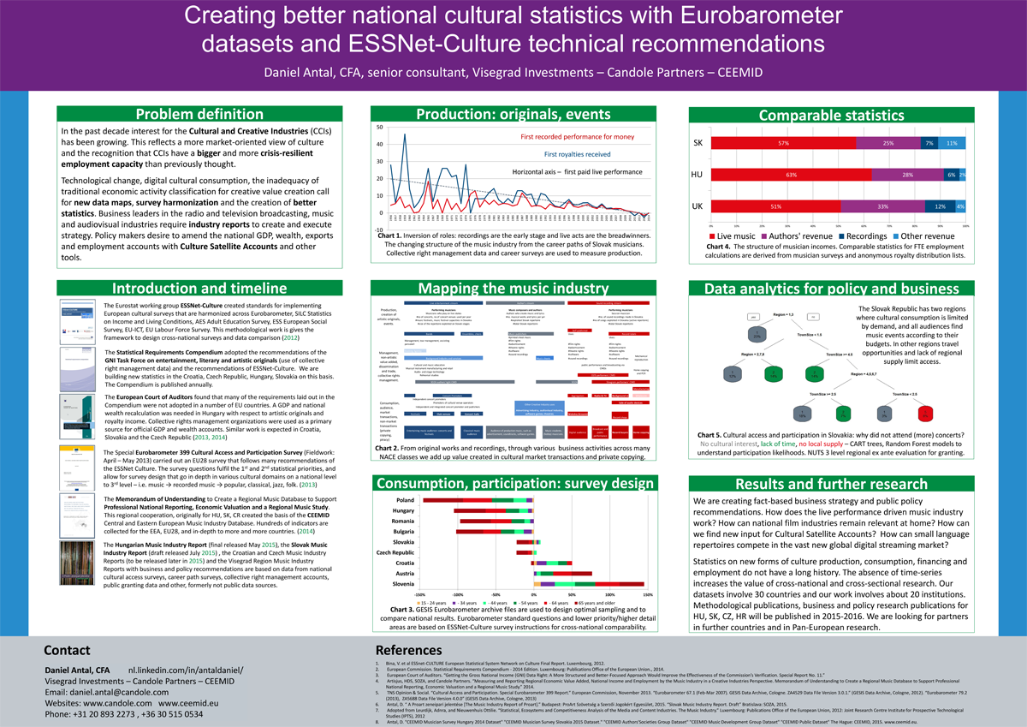
OSINT & Open-Source Market Research
We do what bellingcat does with open-source intelligence in journalism: programmatically sift through vast mountains of open data and try to select and verify those that meet high business, scientific or policy evidence standards.

Slide 10
We aim to increase the quality of existing open governmental indicators, such as Eurostat products, and to design new indicators that are at least on the quality level of Eurostat’s products. Our quality assurance follows the following methodology.
1. Towards a harmonised methodology for statistical indicators — Part 1: Indicator typologies and terminologies - 2014 edition (pdf)
2. Towards a harmonised methodology for statistical indicators — Part 2: Communicating through indicators (pdf) 3. Towards a harmonised methodology for statistical indicators — Part 3: Relevance for policy making (pdf)

Slide 11
What is our technology?

Slide 12
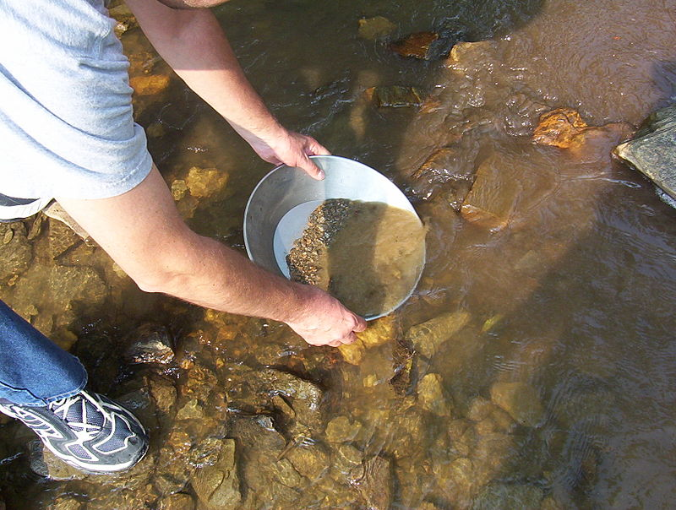
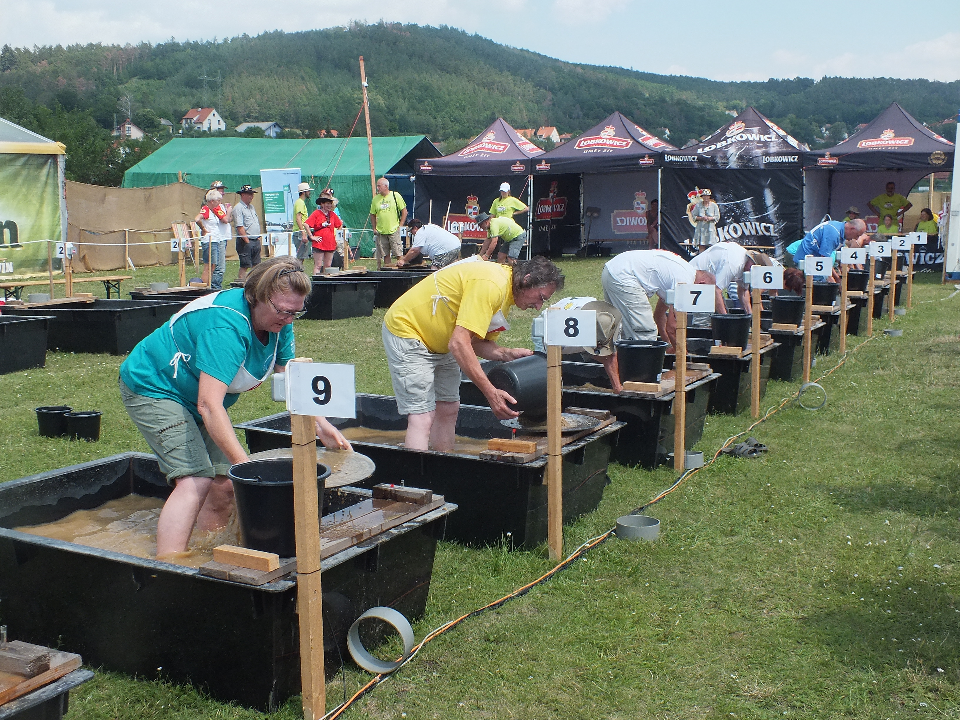
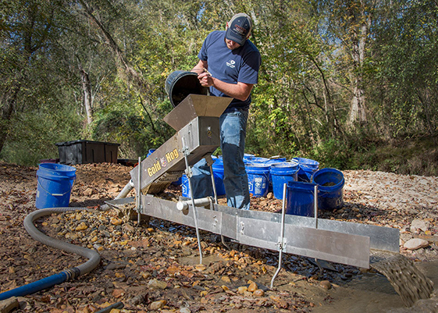
Technology – panning out gold from muddy open sources
Collect
retroharmonize
regions
Re-process
Recode/ transform
Impute, correct
Release
Automatic documentation
Placement in research projects
Iotables
R/Phython
Data API
Validate, test
Our retroharmonize, regions and iotables software has each about 1000-2000 specialist users worldwide.
The users are potential collaborators to pan out more open data and potential clients to produce high-quality research products.

Slide 13

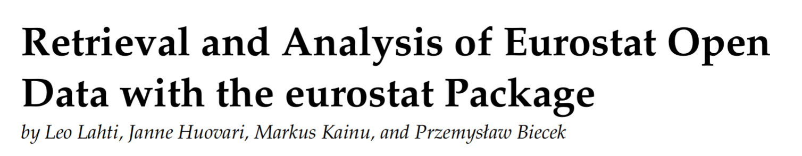
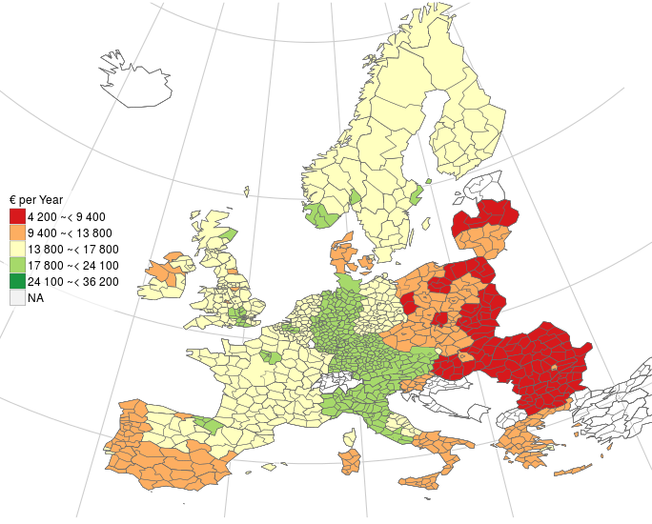
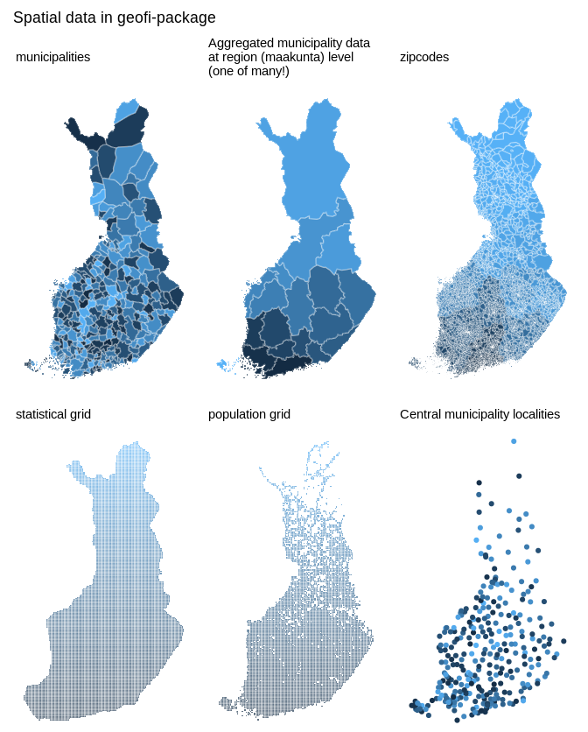
.org
Open developer network for open government data analytics in R
30 R packages in various stages of development; 10,000+ downloads/month
Launched at the NIPS Machine Learning open source software workshop 2013
Active developers from 5 countries; coordinated by University of Turku, Finland
This is a compilation of mature R packages that collectively provide tested tools to retrieve, refine, enrich, integrate, and analyse open government data from Eurostat, national statistical authorities, geospatial information, and other sources
Seamless incorporation of open data streams with state-of-the-art statistical and probabilistic programming techniques and reproducible data science workflows
R Journal 9(1):385-392, 2017
(C) EuroGeographics for the administrative boundaries
Eurostat open data: average household expenditure in 2011

Slide 14
Kasia curated list slide
Combining ex ante and ex post survey harmonization allows to create small scale surveys, such as simpler online surveys, that are more representative, or fully representative of a population.
This method combines new research information with pre-existing information, for example, in the European Values Survey, Eurobarometer, Afrobarometer, EU LFS, etc.

Slide 15
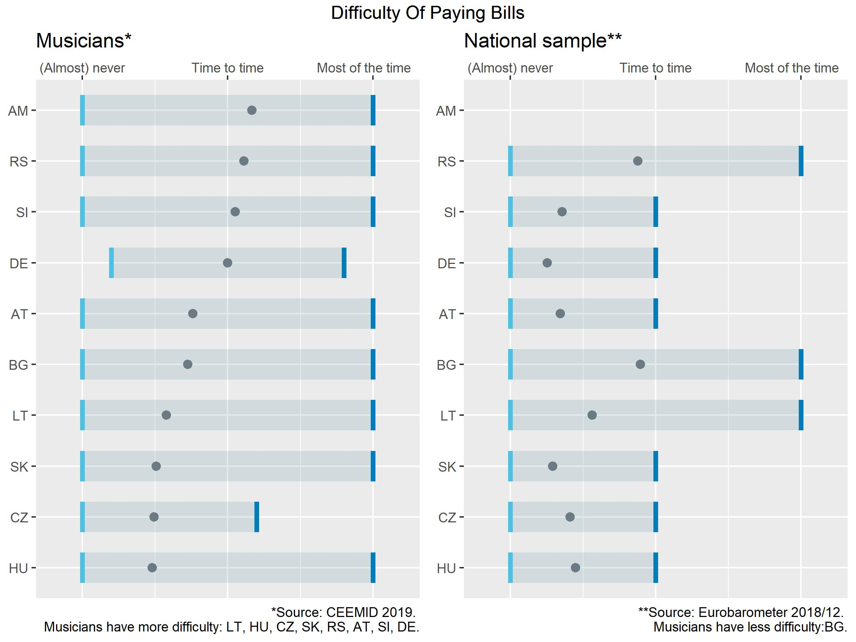
Ex Ante Survey Harmonization
Combining ex ante and ex post survey harmonization allows to create small scale surveys, such as simpler online surveys, that are more representative, or fully representative of a population.
This method combines new research information with pre-existing information, for example, in the European Values Survey, Eurobarometer, Afrobarometer, EU LFS, etc.

Slide 16
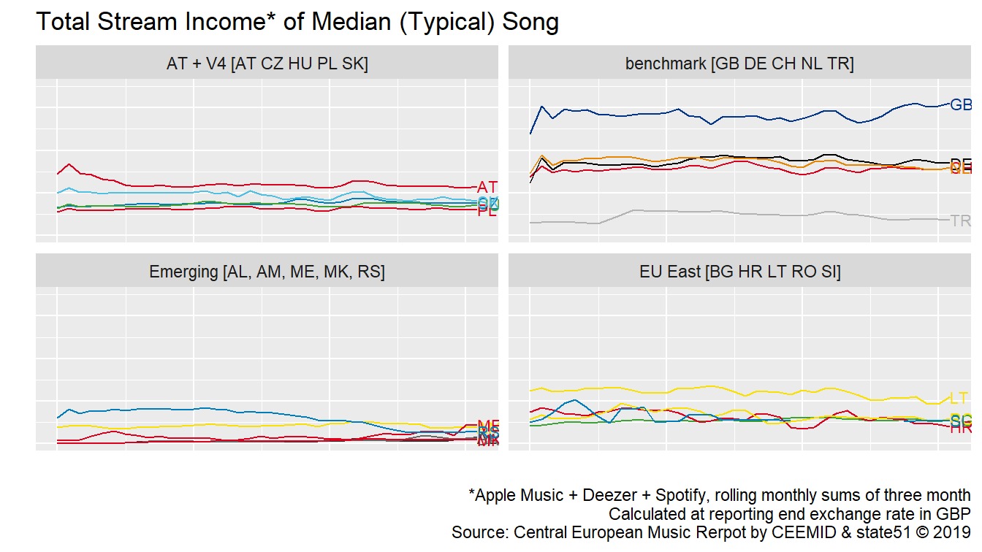
Systematic Sampling of Big Data
Many researchers know how to query the Spotify or YouTbue API, but how to do it in a representative and reproducible manner?
The income of a typical song in 20 countries, 2015-2019, monthly values.

Slide 17
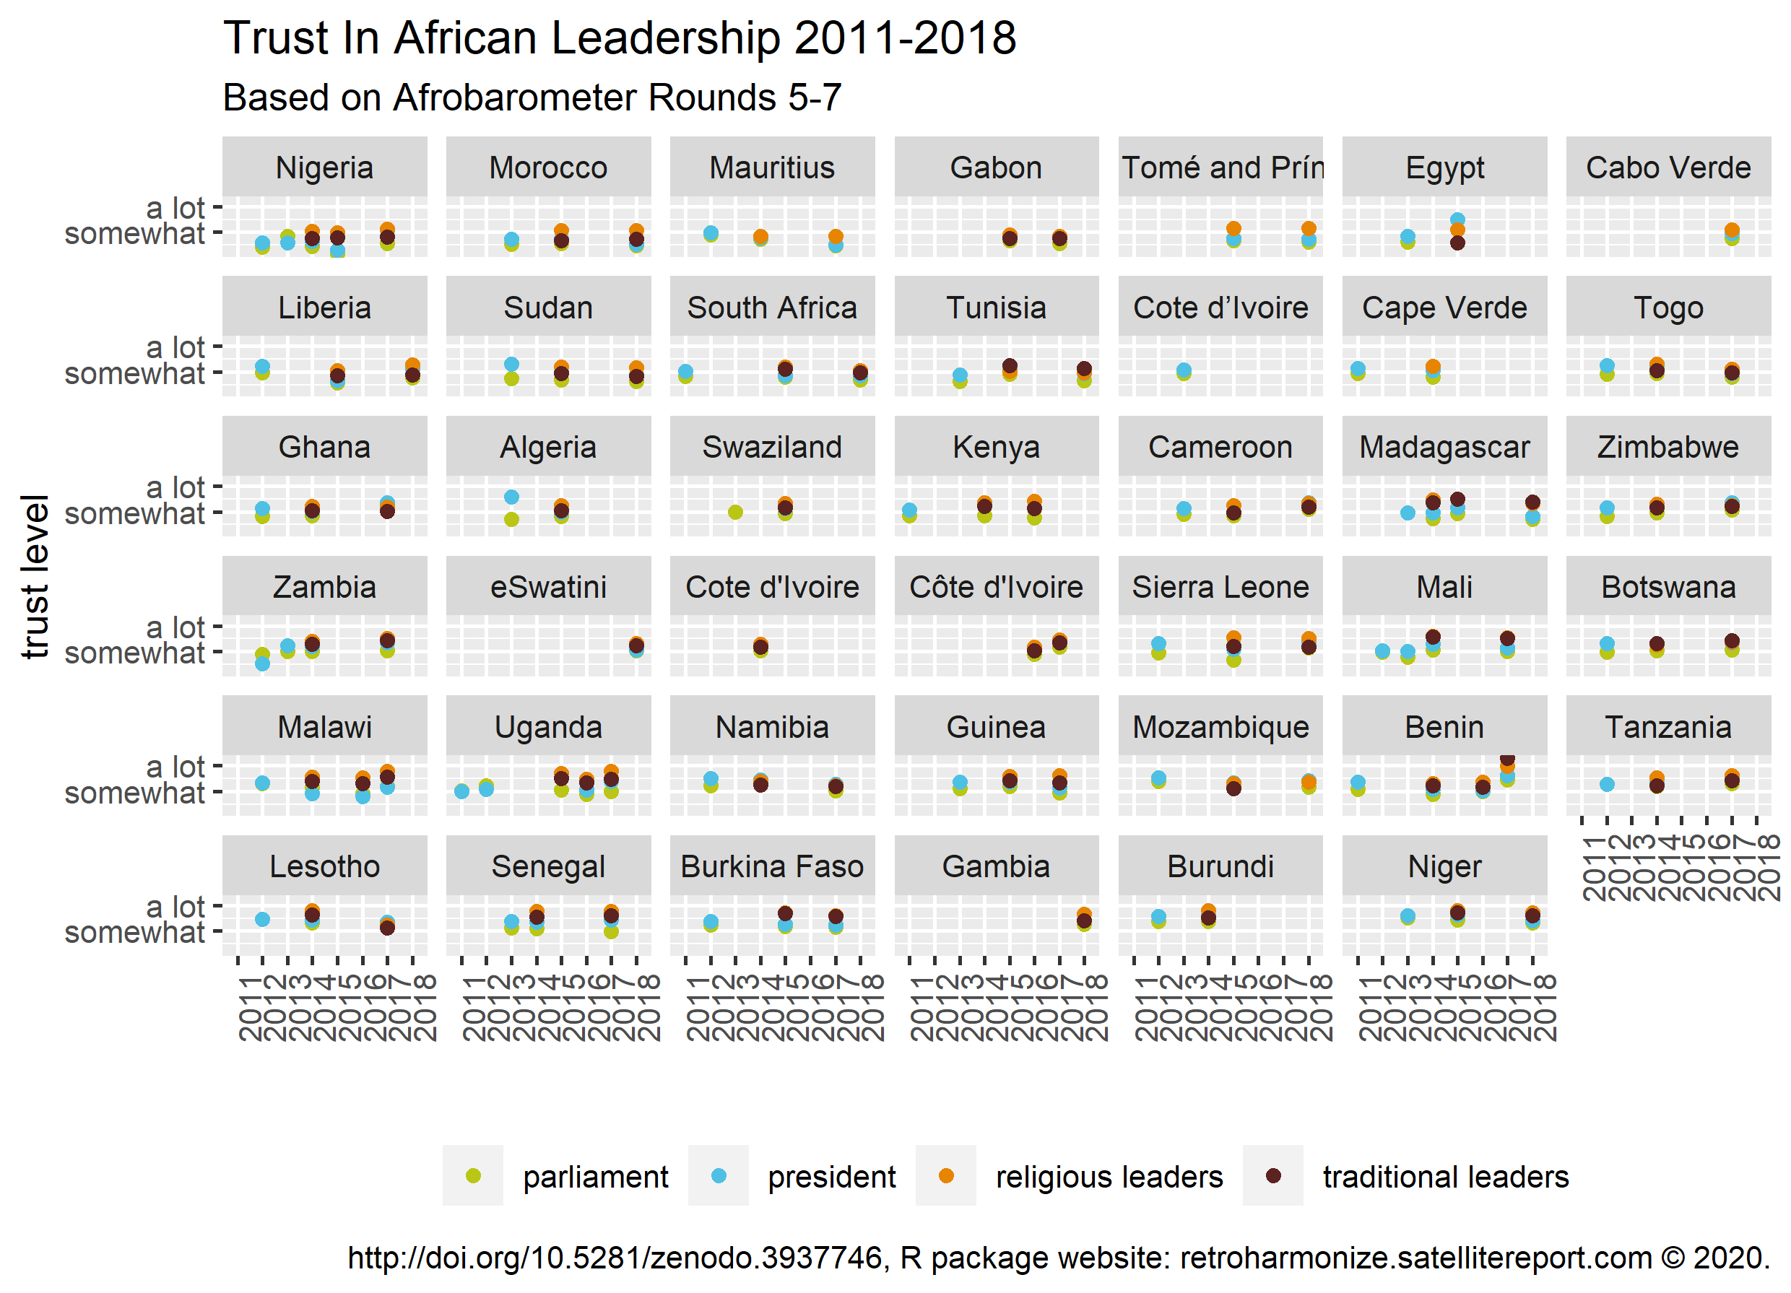
Ex Post Survey Harmonization
Ex post survey harmonization allows the combinations of pre-existing micro-level data, either published, or available for researchers, for example in the Eurostat microdata research.
It can combine international datasets without having to commission a new survey

Slide 18
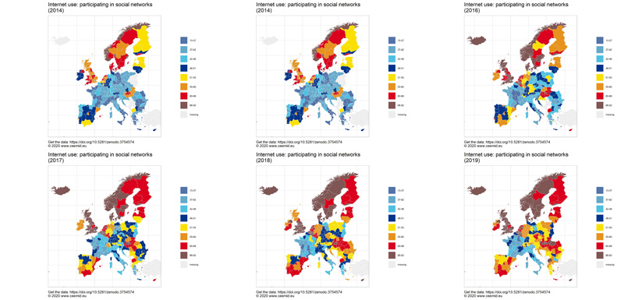
New Statistical Indicators
Statistical agencies and governments collect many-many times more data than what eventually is released as statistically aggregated data products (for example, the GDP or regional GDP indicator, literacy indicators, etc.)
Via rOpenGov and our peer-reviewed statistical softwares, we have access to the raw data of Eurostat and other governmental and scientific agencies covered by the EU Open Data Directive, or similar legislation in other jurisdictions, and using the very same methodology of Eurostat, OECD, we can create similar statistical indicators ahead of the official publication date, or in details that are not published by the statistical agency.

Slide 19
What is our service?

Slide 20
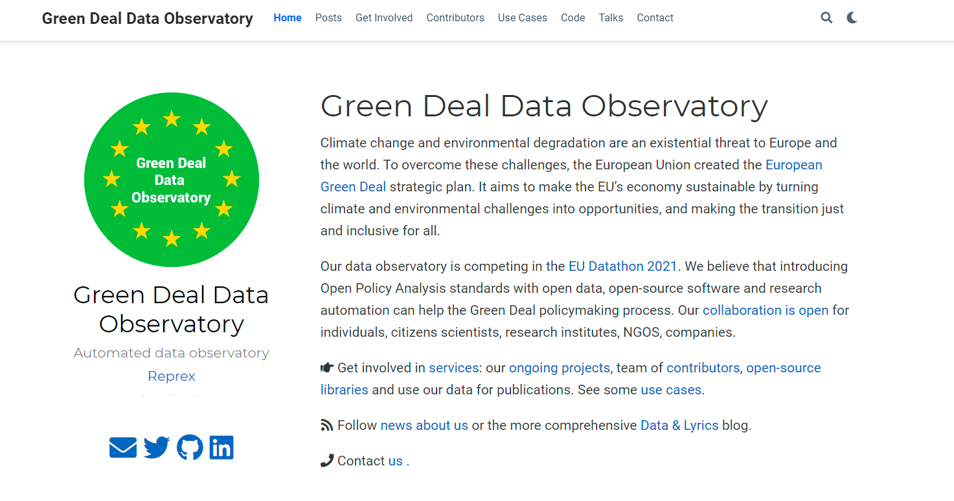
Obervatory specific screenshot

Slide 21
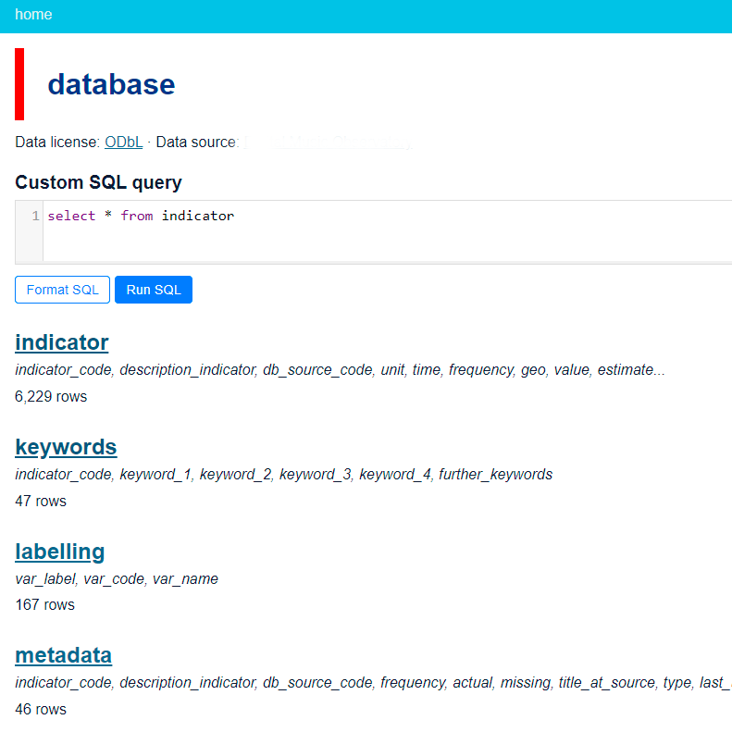
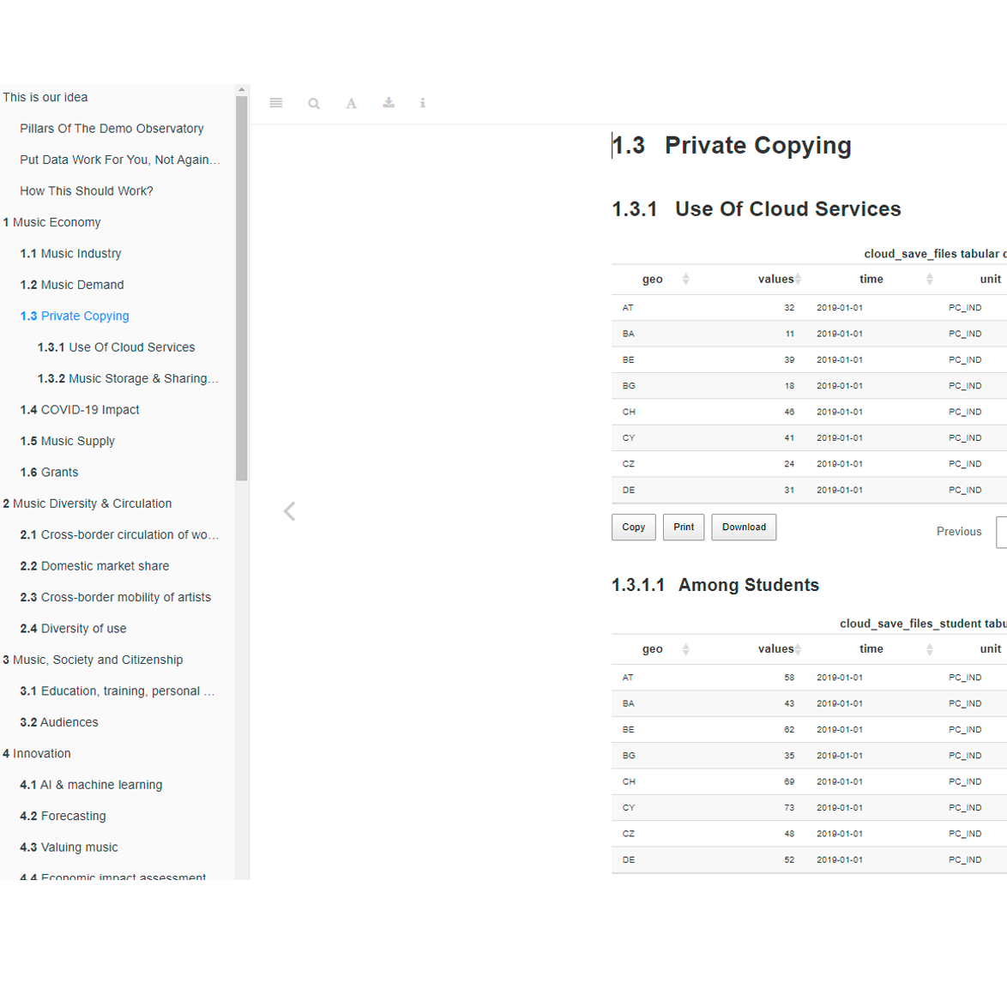
A modern, ODBL open API with daily refreshing indicator, processing and descriptive metadata. Download via SQL or in simple csv tables.
A daily refreshing long-form documentation with explanations, visualizations and human readable metadata.
A dedicated community space on Zenodo for authoritative data copies with DOI.
We would like to integrate our data flow with your research workflow. Our service design team is looking forward to requests from public and NGO policy users, researchers and consultants.
Observatory specific screenshot
Observatory specific screenshot
Website with tutorials and use cases of the data from leading experts.

Slide 22
Data sources

Slide 23
Open governmental data: We access re-usable public sector information covered by the Open Data Directive, and various freedom of information legislation.
Observatory specific text
Open scientifc data: We access re-usable scientific data from the Zenodo repository
Observatory specific text
Data sharing: We are encouraging our users and data curators to share their properietary data through us. Data is getting exponentially more valuable in integration than in isolation. We incentives data sharing with 8 years of industry experience
Big data sources, satellites: We are monitoring various transitory but open APIs, satellite images and other continous “big data” sources and use novel statistical technology to capture them into permanent, reliable and timely statistical, business, policy or scientific indicators.

Slide 24
Obervatory specific data source list

Slide 25
Team credits

Slide 26
Obervatory specific final screenshot

